Slide 1
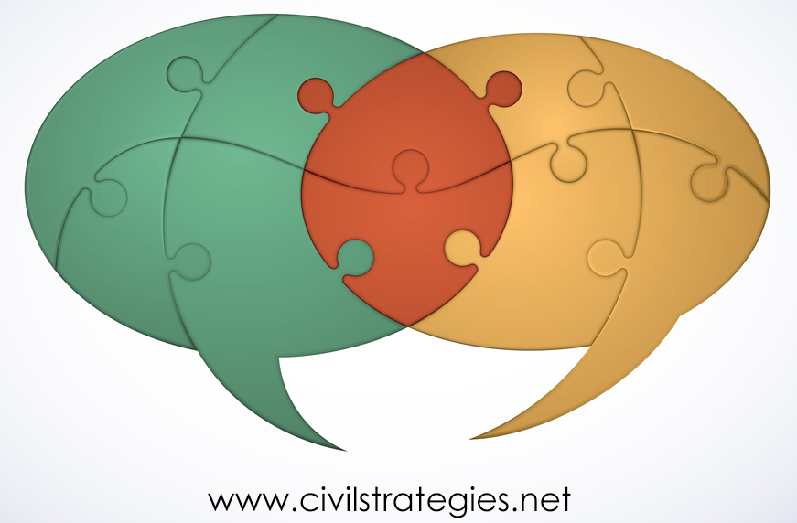
Widening Participatory Dialogue to Improve public ENGAGEMENT AND program Impact
The Expanding Space for Faith-Based Mediating Institutions in the Time of COVID-19
© 2020 Deborah L. Trent, Ph.D.
ARNOVA Conference, November 13, 2020
Notes:
Greetings and thanks to ARNOVA and conference co-chairs Khaldoun and Lindsey for convening this annual meeting in spite of all we’re going through.
I was a U.S. government civil servant for 15 years and in the last two decades have worked with global to local nonprofits on citizen engagement, public and citizen diplomacy program design, management, and evaluation. These days I continue consulting on global educational and cultural programs, in addition to community organizing and serving as a pracademic-in-residence at Community Mediation Maryland.
This presentation is one of a series of case studies for an ethnographic memoir, Listen, Mediate, Understand, Transform: Catalyzing Diversity for Social Justice, One Conversation at a Time.
It’s the story of how my congregation and a partner organization have helped me and others in my community work through pandemic grief and foster social justice, so I’d like to start with some uplifting music from the August 16th Sunday service I viewed on the YouTube channel of the church I studied.
Sunday Worship: Masters of the Universe
August 16, 11 AM
with Rev. Dr. Bill Sinkford
Postlude: We Rise: “Love Bigger,” Darrell Grant, First Unitarian Church, Portland, OR
https://www.youtube.com/watch?v=T7nFjU2jsRk&feature=youtu.be
1:09:25 to 1:11:42

Slide 2
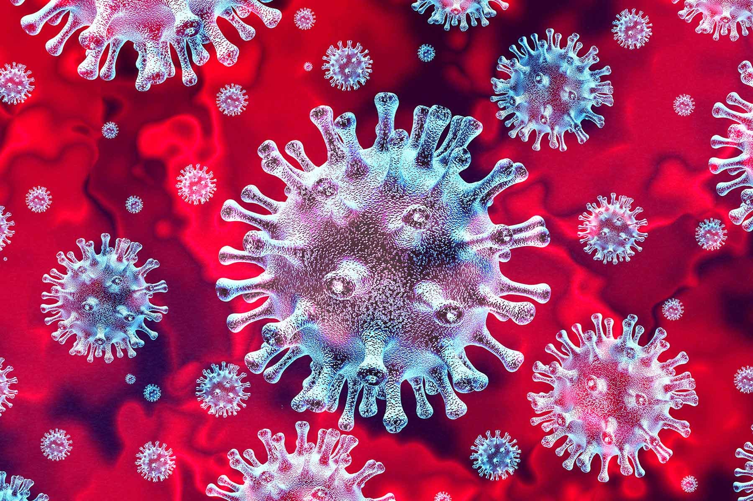
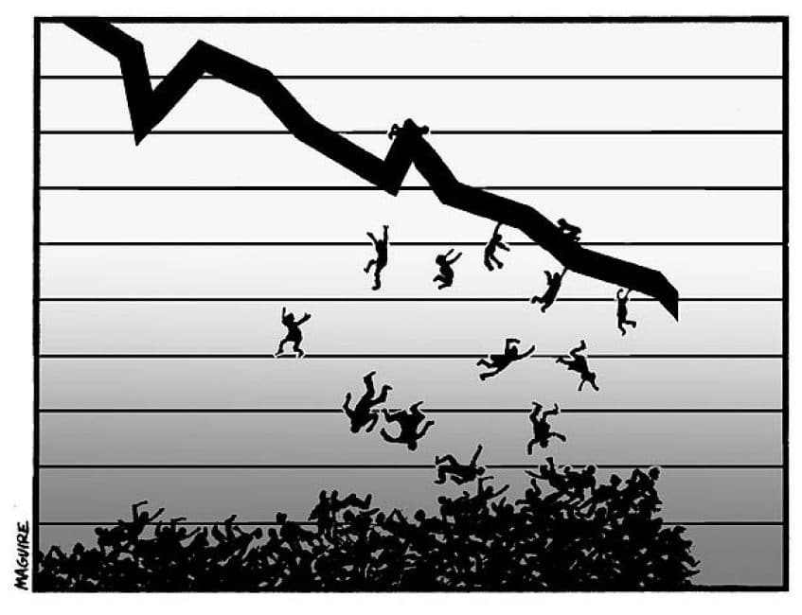
Not Just One, but Four Pandemics
Notes:
The brute force of the quadruple pandemic has exposed so much corruption, so much grief. Civil society mediating institutions have been encouraging hope and resilience on the individual and community levels. The two faith-based organizations featured in this study employ relational organizing and YouTube to meet the spiritual and material needs of their members and wider communities in the face of these social, economic, and political crises.
https://img.webmd.com/dtmcms/live/webmd/consumer_assets/site_images/article_thumbnails/other/1800x1200_virus_3d_render_red_03_other.jpg
https://mronline.org/wp-content/uploads/2017/08/Economic-Recession-and-Vulnerable-Workers.jpeg
https://lohf.org/wp-content/uploads/2020/06/Trauma-of-systemic-racism-FB-1.jpg
https://www.michaelshank.tv/wp-content/uploads/2013/10/polar-bear1-460x250.jpg

Slide 3
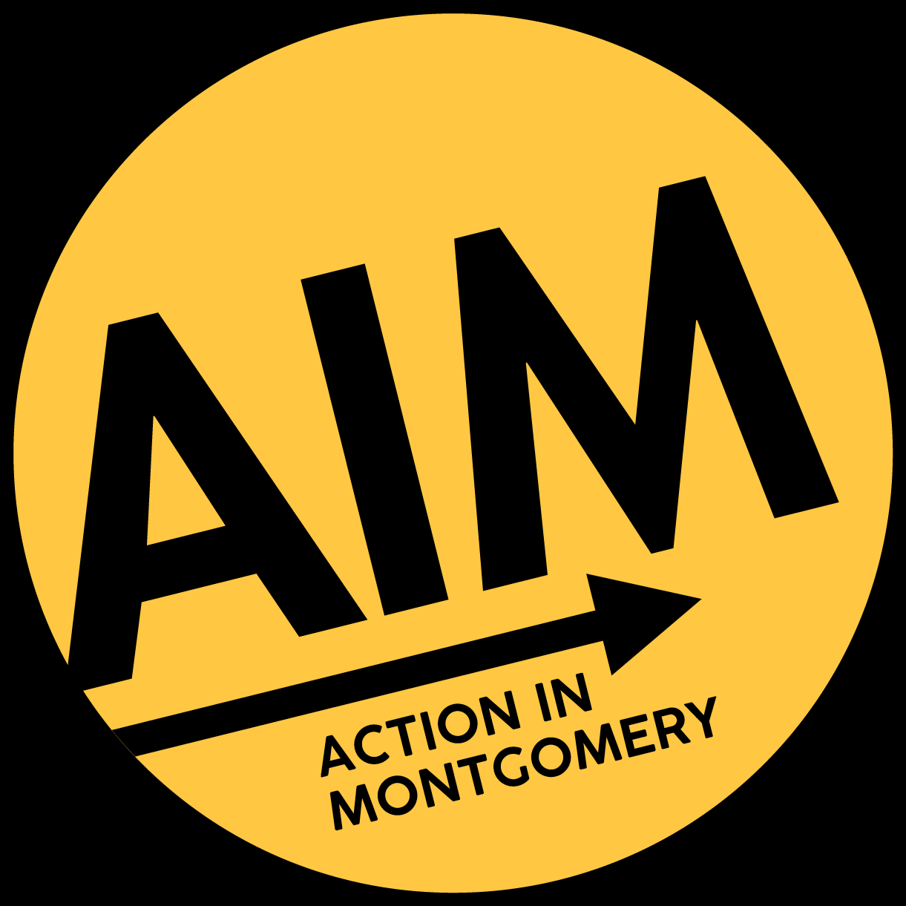
The Mediating Institutions
Notes:
In addition to my family and friends., these are the civil society organizations where many in my community have been lucky this year to have garnered support. According to Timothy Worth, mediating institutions promote a “sense of individual and shared responsibility, identity, relationality, accountability, and capacity to manage conflict.” Paraphrasing my dissertation and Denhardt & Denhardt’s New Public Service, ‘civil society….includes the family and other institutions that mediate the desires and interests of citizens and … provide experiences that will better prepare those citizens for action in the larger political system’. Mediating institutions include labor unions, professional groups, religious organizations, civic associations, clubs of volunteers, social groups and athletic teams that ‘help establish connections between the individual and the larger society….[where] people need to work out their personal interests in the context of community concerns’ (2007, pp. 33-34).
Cedar Lane and AIM, both located in Montgomery County, are exemplars of these characteristics. Cedar Lane is a liberal protestant church centered on “love and support [to] one another” that enables more ‘support [to] the local community and beyond’ “to build a more just world.” Cedar Lane is a founding member of AIM, the first suburban affiliate of the interfaith, broad-based organizing network called the Industrial Areas Foundation. Cedar Lane and AIM members have been participating in social action to identify and address pandemic-related problems that none of us as individuals could address alone. These shared experiences have helped console our personal grief this year and sharpen our focus on larger societal problems.
---------------------
Sources:
59. Fort, Timothy L. “Corporation as Mediating Institution: An Efficacious Synthesis of Stakeholder Theory and Corporate Constituency Statutes.” Notre Dame Law Review, vol. 73, no. 1, 1997, p. 175. 60. Zaharna, R.S. “Diversity in Publics and Diplomacy.” Working Paper, Project “Diplomacy in the 21st Century,” no. 15, Stiftung Wissenschaft und Politik (SWP)/German Institute for International and Security Affairs, 2017.
Participation is a “mediating institution” (Berger and Neuhaus 1996; Lando 1999 ) through which a synergistic climate contributes to problem solving ( Lawrence and Deagen 2001 ).
(Wang & Wart, 2007, When Public Participation in Administration Leads to Trust) (Trent 2018 p. 16)

Slide 4
CONTEXTUALING THE QUADRUPLE PANDEMIC
The physical distance of COVID-19
Systemic racism
Economic recession
Climate change
Accessible online video technology
Notes:
Physical distancing during COVID-19 has required retooling of our communication modes to remain social while distant; community-based mediating institutions have bridged us, virtually and safely. Cedar Lane and AIM have used YouTube and Zoom to keep people connected, motivated, and engaged. They have spurred collective action to address the oppressive experience of systemic racism, economic recession, and climate change during the pandemic, shoring up county government services and pushing for racial equity and social justice reforms.

Slide 5
MEDIATIONAL PROCESSES I
Fostering democratic governance
Being accountable, socially responsible, including as a dimension of leadership
Relational and transformational dialogue, e.g., listening to more than talking at, deliberating how to cope, hope and change
Relational organizing
Direct service delivery (distributing food, money, shelter to the needy)
Environmental ministry and stewardship
Notes:
In the past eight months, I have observed at least 15 mediating processes in the Cedar Lane and wider AIM communities. This short talk allows only a list. A few examples, in the green font, will be discussed.
Fostering democratic governance
Being accountable, socially responsible, including as a dimension of leadership
Relational and transformational dialogue, e.g., listening to more than talking at, deliberating how to cope, hope and change
Direct service delivery (distributing food, money, shelter to the needy)
Environmental ministry and stewardship
Pastoral care-giving

Slide 6
MEDIATIONAL PROCESSES II
Pastoral care-giving
Sharing spiritual and musical traditions
Advocating moral public policy
Strengthening families and cross-generational ties
Increasing participation, inclusion, collaboration
Developing technical capacity
Fostering safety
Searching for belonging
Being humble, appreciative, grateful
Notes:
Sharing spiritual and musical traditions
Advocating moral public policy
Strengthening families and cross-generational ties
Increasing participation, inclusion, collaboration
Developing technical capacity
Fostering safety
Searching for belonging
Being humble, appreciative, grateful

Slide 7
SAFELY AND COMMUNALLY ADDRESSING GRIEVANCES
Poverty Amidst the Pandemic: A Moral Response @38:37 https://www.youtube.com/watch?v=QUOYf9mE8IA (watch for two minutes)
The Story of South Lake @ https://actioninmontgomery.org/southlake/
Notes:
The Sunday, May 31st service of Cedar Lane livestreamed on YouTube is entitled “Poverty Amidst the Pandemic: A Moral Response.” @38:37 https://www.youtube.com/watch?v=QUOYf9mE8IA. I’ll play a couple of minutes of the recording to show how Cedar Lane’s participation in the national Poor People’s Campaign demonstrates advocacy of moral public policy, fostering democratic governance, prompting many viewers to donate to the weekly Share The Plate and to join the ministers in subsequent marches in DC with the campaign. It and the service also engaged children, strengthening families and cross-generational ties, and involved sharing spiritual and musical traditions. I’d also note that Cedar Lane began livestreaming services on YouTube prior to the covid-19 pandemic, but by mid-2020, the all-volunteer AV Team had developed extensive skills in Open Broadcaster Software, the Acapella musical performance app, anti-virus procedures, and tech support.
The July 12th service included an ongoing AIM campaign to modernize the highly ethnically diverse and mostly lower-income South Lake Elementary School in mid-county Gaithersburg, Maryland. AIM’s advocacy has been directed to the millions of dollars in capital funding needed to reconstruct the campus. Here is a short clip from AIM’s YouTube, “The Story of South Lake.” https://actioninmontgomery.org/southlake/ . You get the idea. The congregation’s response, participation in another Share The Plate and an email campaign to the County Council, are also examples of being accountable, socially responsible, including as a dimension of leadership, of strengthening families and cross-generational ties, and of fostering democratic governance .
But the principal mediational process of AIM and the IAF is relational organizing, a foundation of which is “building interpersonal relationships that can be mobilized for collective action,” according to Erhardt Graeff and in my own experience for 15 years as a volunteer leader with AIM. AIM and other IAF organizations ‘bring[] together community residents drawn from its various faith houses to deliberate community needs and capabilities. Out of these discussions, a commitment emerges to act to achieve winnable goals that can improve the community,’ as explained by Mark Warren.
Louise Green, a United Church of Christ minister, has directed social justice ministries at various UU congregations, and is a community organizer with more than a decade with the Industrial Areas Foundation. She writes that the first and second principles of Unitarian Universalism are affirming the inherent worth and dignity of every person and promoting justice, equity and compassion in human relations. In this context, especially in large congregations with bureaucratic structures, close relationships between individuals are often sacrificed. Relational organizing temporizes that tendency and can even be transformative. In times of crisis within and around a congregation, individual relationships and a relational culture offer people space to be flexible and responsive to growing or changing needs.
I posed several questions to AIM’s lead organizer about relational organizing during the covid-19 pandemic. On the challenge of keeping in contact with member congregations and individual leaders, she responded that in some ways it’s been easier to get geographically disparate people together on a regular basis on Zoom and for people to come to, for instance, political meetings with elected officials in the middle of the day. She doesn't think they're staying in as good touch with leaders--partially because of her and her co-organizer’s child care responsibilities, and there is only so much Zooming and YouTube streaming you can do without going crazy. She reflected that there is also something intangibly irreplaceable about sitting with someone in their kitchen and talking to them. Some people fell further away, and it is much harder to build new trusting relationships virtually. And as far as public impact goes, she noted that AIM has had larger attendance at countywide actions and more press coverage because it's easy for the press just to watch online, and AIM action teams can bring together people of more diverse backgrounds, particularly since they don't have to drive long distances across the county to get to the meetings. She rated the effectiveness of virtual technology for individual meetings as low, middling for actions with public officials, and higher for actions including press conferences.
Yes, there are shortcomings to virtual relational and community organizing as well as other virtual social justice efforts among faith-based institutions, but their advantages outweigh their disadvantages. They are safer, and in some cases increase diversity of participation and inclusion. As more in Generation Z take leadership positions, mediating pandemics and other future crises will increasingly be situated in virtual spaces.
-------------------------
(52-53, Warren, Faith and Leadership in the Inner City: How Social Capital Contributes to Democratic Renewal, in Smidt, ed., 2003).
Erhardt Graeff 2018, p. 1
As co-director of Metro IAF, Michael Gecan wrote in Effective Organizing for Congregational Renewal (2008) of the four tools to build a relational culture and stir energy, commitment and organizational accountability to effect community change: individual meetings; power (relational) analysis; teaching and training; and action and evaluation.

Slide 8
Thanks! Questions?
dtrent@civilstrategies.net
@dlt4PD
Notes:
It’s been a privilege to share some of this research with you.
I look forward to our discussion today and off-line.

