Slide 1
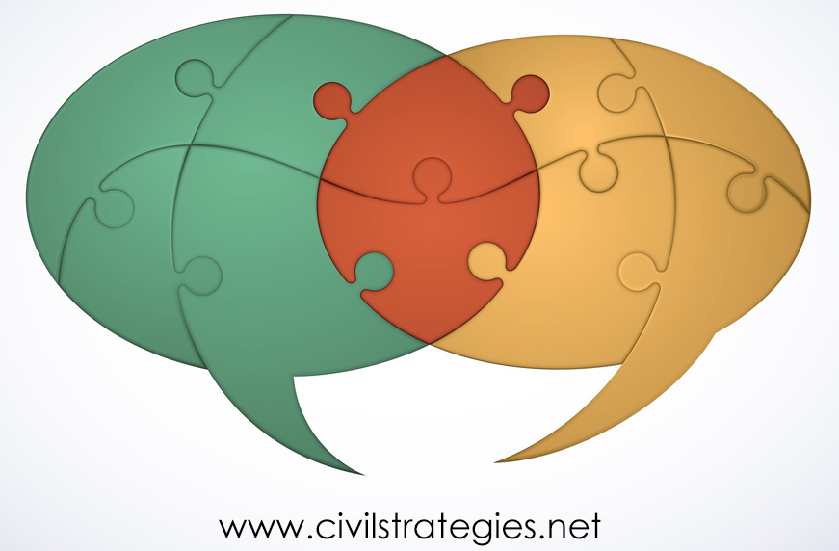
An Inclusive, Participatory Design, Monitoring and Evaluation Process-Tool to Widen Participatory Dialogue and Improve Impact in Diplomacy and Peacebuilding
© 2018 Deborah L. Trent, Ph.D.
M&E Thursday Talk convened by dm&e for Peace
16 August 2018
Notes:
(Greetings)
I’ve worked in the U.S. government and at partnering nonprofits on public and citizen diplomacy program design, management, and evaluation. These days I’m a “pracademic” and consultant in the Washington, DC area.
My most recent project – “Many Voices, Many Hands: Widening Participatory Dialogue to Improve Diplomacy’s Impact” – is the second applying concepts and tools shared on the dm&eorpeace platform and in many Thursday Talks.
I hope that “Many Voices, Many Hands” is as relevant to the peacebuilding community as to diplomats and their implementing partners. Supported by a fellowship with the University of Southern California’s Center on Public Diplomacy, I’ve developed a participatory dialogue approach drawing on cross-sector international partnership programs I’ve managed, and diaspora engagement I’ve analyzed and participated in.

Slide 2
Outline
A Theory of Change through Strategic Political Engagement
Concepts, Context & Process for Widening Stakeholder Participation, Dialogue &
Impact
Analytical Methods & Variables
Findings
Strengths & weaknesses
Applications
2
Notes:
https://cdn.pixabay.com/photo/2018/07/14/01/55/kei-islands-3536900__340.jpg
I’ll start with an underlying theory of political change and sketch a conceptual framework including some assumptions about strategic political engagement and what compels it. Then, I’ll move to methodology, methods, and findings that have led to this participatory dialogue-DM&E approach.
The challenge is to make the approach qualitatively and, when feasible, quantitatively rigorous, yet practical for small and large-scale programs. The approach should also facilitate project reporting and advocacy.
I look forward to your questions and “reality check” on the approach.

Slide 3
Politics & Strategy
3
Notes:
https://pixabay.com/en/photos/?q=gorilla
https://pixabay.com/en/photos/?q=strategic
The 800-pound gorilla in the room of strategic diplomacy and peacebuilding is power politics. Politics are broadly defined as interpersonal and inter-organization relations; partisan or not.
In diplomacy between governments, and in public diplomacy – the space where government agencies from the local to the global – or “glocal” level reach out to engage with non-state state actors, politics have always fascinated and frustrated me. I bet you can relate, whether your field is cultural, educational, economic, gender- or environmentally based.
Diplomats and peacebuilders need to present themselves, their funders’/governments’ interests, and their program ideas as credible and in the best interests of local stakeholders and funders. To do that, they need to form strategic partnerships with stakeholder groups sharing specific interests, and to collaborate on effecting and measuring change in political behavior.
The organizing theory of change underlying this participatory dialogue approach for evaluating impact in public and citizen diplomacy and peacebuilding is two-fold. The first source of change is in opening up policy dialogue by widening participation – thereby strengthening mutuality and credibility-by including diverse, affected stakeholders – known as “strategic publics.” Second, change happens when project partners measure both the quality of communication in relationship-building and the quantitative material results of the relationship-building and projects they undertake. The shorthand for this inclusive, strategic stakeholder participation in relationship-building and project DM&E is “strategic engagement.” Because the approach stresses inclusive, participatory DM&E, it stands to foster an organizational culture of research and evaluation in the diplomacy and peacebuilding communities.

Slide 4
Context & Process in Strategic Engagement
Global Politics
Public Diplomacy
Peacebuilding
Citizen Diplomacy
Development
4
Notes:
Within global politics are situated: non-official, citizen-to citizen diplomacy; official governmental global to multi- and bilateral and then subnational/state and city diplomacy.
Public diplomacy is official, but it also involves civil society and the private sector.
Development is the goal of much official and, increasingly, citizen diplomacy.
Peacebuilding happens within all of these spaces.
The more development and diplomacy involve citizens and community organizations, the more informal the engagement is.
The politics of inclusive, participatory, strategic engagement in diplomacy, peacebuilding and development can be operationalized as context and process variables.
Context variables are the social and historical conditions motivating desire for political change.
Process variables are the behaviors, in this study, of partner agencies and organizations and other lead stakeholders, influencing the design, monitoring, results, evaluation, and sustainability of their educational, cultural, economic, and peacebuilding projects.

Slide 5
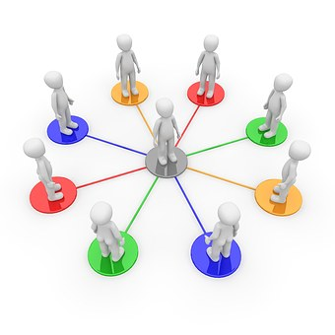
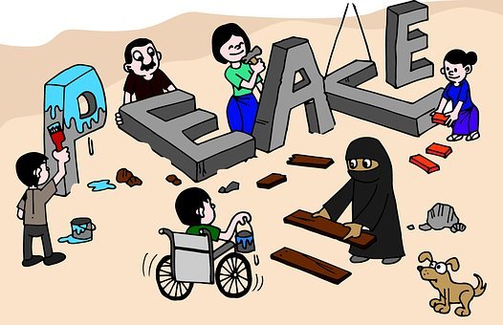
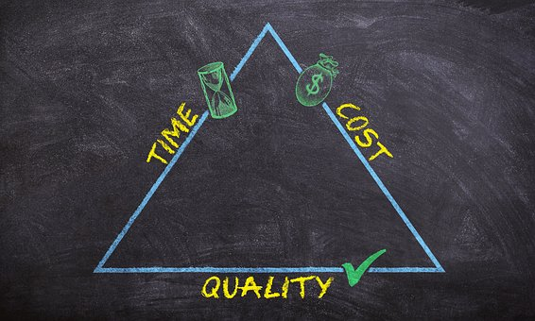
Context & Process Operationalized
Partnerships
Participation
Identity
5
Dialogue
DM&E
Notes:
https://cdn.pixabay.com/photo/2012/12/14/11/36/virtual-identity-69996__480.jpg
https://cdn.pixabay.com/photo/2015/11/03/08/54/network-1019778__480.jpg
https://pixabay.com/en/photos/?q=process&pagi=2
People with dialogue signs is from USC so also probably CC
https://cdn.pixabay.com/photo/2017/05/06/05/33/peace-2288958__480.jpg
1. Power politics of all kinds – identity, gender, national, tribal, water, trade – involve diverse stakeholders, requiring mediation in order to effect positive behavioral change. Diplomats and peacebuilders mediate relationships to build trust, cooperation, and strong partnerships.
2. As a multi-stakeholder collaboration process, partnership can be a particularly credible and effective mediating process for administering services and projects involving diverse stakeholders and program implementers. Public-private partnerships , or P3s, offer broad opportunities for fostering mutual understanding and economic opportunity.
How do we operationalize the contextual and process variables required to mediate P3s?
3. In the present dialogic, participatory approach to DM&E, the contextual variables include the complexities of national and subnational diplomacy due to globalization, the rising power of diverse non-state actors, and the challenges in translating strategy to programs. Here, the programs are US-government-funded global partnerships and sister city partnerships.
4-5. Key diplomatic processes for DM&E in this context are cross-sector partnering, mediating and dialogic, participatory communication.

Slide 6
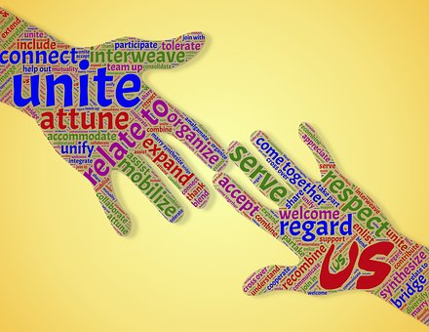
Dimensions of Mediating
Conflict Mediation
Managing Mediatization
Relationship-building
6
City-to-City Cooperation
Integrated DM&E
Notes:
https://pixabay.com/en/photos/?q=control
https://pixabay.com/en/photos/?q=mediating
https://pixabay.com/en/photos/?q=relate&hp=&image_type=all&order=popular&cat=&min_width=&min_height=
https://pixabay.com/en/photos/?q=relate&hp=&image_type=all&order=popular&cat=&min_width=&min_height=
http://www.iuc.eu/city-pairings/
Mediating global politics has five key dimensions:
1. Administering new and expanded relationships.
2. Negotiating, representing and managing mediatizing forces and their increasingly advanced and accessible communication technologies.
3. Providing conflict mediation.
4. Promoting city-to-city, cross-border cooperation.
5. Integrating project DM&E from the outset of project planning.

Slide 7
Participatory Communication
Relationship-Building
Mid-Term Adjustments
Advocacy
Genuine Dialogue
Inclusive Design, Monitoring & Evaluation
Mediating
Strategic
Engagement
7
Notes:
At a high level, mediating strategic engagement is cyclical, from genuine dialogue to advocacy.
Measures of the genuine dialogue, participatory communication and relationship-building process variables are discussed in upcoming slides.
Inclusive design, monitoring & evaluation begin with stakeholder dialogue and continues throughout engagement.
Mid-term adjustments are a logistical and political reality check.
Evidence-based advocacy is informed cumulatively by all prior processes.

Slide 8
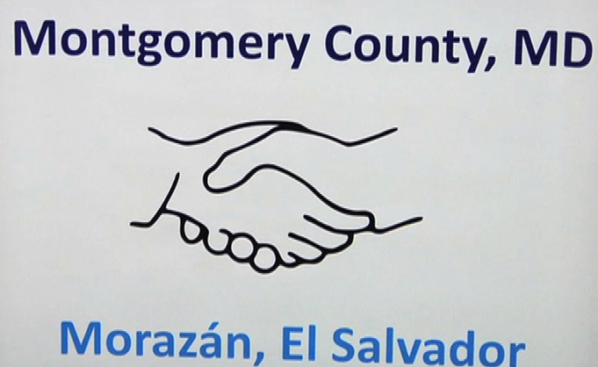
Three Test Cases
8
Notes:
In this study, the strategic engagement value of relationship-building through inclusive, participatory dialogue and DM&E are measured post hoc in three cases of public and citizen diplomacy, situated primarily in the United States.
The International diaspora Engagement Alliance (IdEA) – has been funded by U.S. Department of State and Agency for International Development, and Calvert Impact Capital (formerly Calvert Foundation) was the managing partner from 2013 to 2016.
The Chicago-Kyiv Sister City partnership was established in 1991.
The sister city agreement between Montgomery County, Maryland, and the El Salvadoran state of Morazán was inked in 2011.
The three meet the selection criteria of cross-sector relationship-building that include: demographically diverse, global publics – i.e., ethnic diasporas; significant contribution of resources from the public, nonprofit and private sectors; glocal public sector stakeholders; and program goals spanning education, culture, health, trade & tourism, good governance and philanthropy.
http://www.diasporaalliance.org/
http://www.chicagosistercities.com/events/gala-banquet-for-the-25th-anniversaries-of-ukrainian-independence-and-the-sister-city-anniversary-between-chicago-and-kyiv/
http://s19499.pcdn.co/wp-content/uploads/2012/04/Salvadoran-Delegation-CRTW-Ep.106-04-27-12-e1423764710896.png

Slide 9
Measuring project Communication quality and material results
Genuine Dialogue
Participatory Communication
Foci
Outputs
Outcomes
Impacts
Notes:
The quality of communication among partners and stakeholders in the three cases is measured with a rubric combining “genuine dialogue” and “participatory communication.”
Genuine dialogue connotes mutual, deliberative, “power-free” decision-making to navigate complicated global networks of communities with shared and divergent interests.
“Participatory communication” draws on stakeholder management and corporate social responsibility to aid in identifying with whom to engage strategically, as well as relationally.
Material results of IdEA, Chicago-Kyiv, and Montgomery County-Morazán are measured as outputs, outcomes and desired impacts generated through the dialogic, participatory communication and relationship-building in the partnerships.
Interviews, document and media analysis and participant observation were the key data gathering methods for measuring strategic engagement in these P3s.
The next two slides display the rubric of dialogic and participatory relational qualities or “tactics” of strategic engagement.

Slide 10
10 (table continued on next slide)
Notes:
Dialogic and participatory communication marries eight genuine dialogue and 15 participatory communication practices to mediate the diversity of stakeholder experience and perspectives in strategic engagement.
Part 1 of the table, pictured here, contains five of the 15 participatory communication practices – from Listening Openly to Jointly Strategizing, Implementing, and Evaluating. They are cross-referenced with the eight genuine dialogue practices – from Mutuality to Risk.
Some of the practices reinforce one another – as indicated by the blue inverted triangles. For example:
The participatory communication practice of listening openly to absorb multiple perspectives in problem definition, goal-setting, reporting and codifying DM&E processes reinforces the dialogic acts of presence and respect. Here, diplomatists are in close proximity and open to engaging with diverse stakeholders affected by a current or contemplated program before its implementation. Respect comes in recognizing these stakeholders as strategic publics.

Slide 11
11
Notes:
Here are the remaining ten participatory communication practices, from Increasing Horizontal Dialogue to Experimenting with various projects to Transform behavior and Sustain the change.
Examples of the strategic value of designing messages together was found in both sister city exchanges, whether in the humanitarian work of Chicago-Kyiv providing relief to Ukrainians during the Maidan revolution or the Morazán committee building on the Salvadoran Vice President’s and Montgomery County Council president’s messages of hope that Salvadorans in the county continue contributing remittances as well as human resources and infrastructure and to break down racial barriers. The genuine dialogue practice of Risk and Deliberative participatory communication came up in this connection, too, when a Maryland participant recalled how she decided to take her daughter to Morazán although her husband was initially not in favor and was only convinced after they both talked through the decision. Mother and daughter ended up making multiple trips, many years in a row, to volunteer and sight-see.

Slide 12
Analysis and findings
12
Notes:
https://cdn.pixabay.com/photo/2015/11/03/09/03/magnifying-glass-1019982__480.jpg
Now we’ll move from qualitative measurement of relationship-building to assessing outputs, outcomes and impacts.

Slide 13
13 (table continued on next slide)
Notes:
Here and in the next slide, the program foci and material results of the Chicago-Kyiv Sister Cities are displayed. These results were facilitated through the dialogic, participatory communication and relationship-building in the partnership. This sister city is one of Chicago’s most active.
Outputs are completed, discrete activities, for example: cultural events, scholarship fundraising, and exhibition sports.
Outcomes are specific results from outputs, such as expanding educational and cultural opportunities for Ukrainian youth, and strengthening ties between the agricultural and manufacturing sectors
Impacts are the desired goals generated by outcomes, including higher quality mental and physical health care delivery, and greater transparency in government and the private sector.

Slide 14
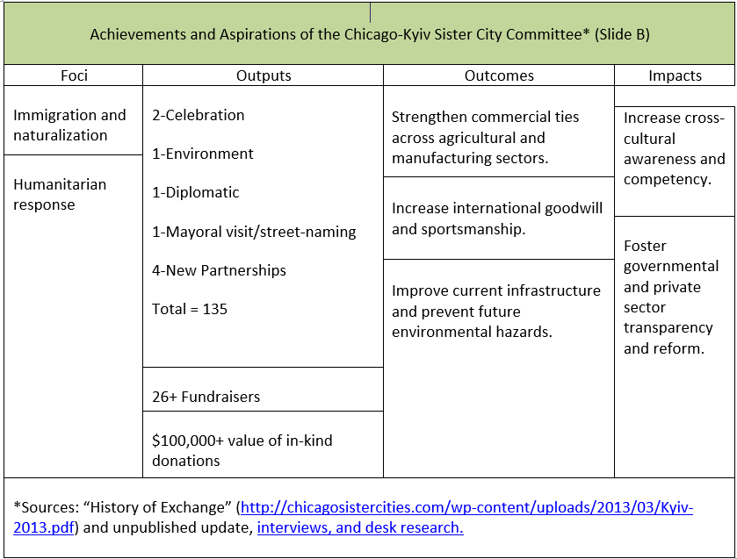
14
Notes:
Part B of the table shows the last two of the seven foci of the Chicago-Kyiv sister cities, along with the remaining output activities, and over 26 fundraising events generating more than $100,000 in donated goods and cash. Three higher-level outcomes and two additional desired impacts complete the partnership’s achievements and anticipated results.

Slide 15
Theories of Change
IdEA: Using an events strategy to offer networking and tailored training opportunities along with mentoring and small grant programs, IdEA seeks to increase diaspora integration into diplomacy and development and promote investment, entrepreneurship, philanthropy and volunteerism in heritage countries.
Kyiv: With limited financial support for exchanges, the experienced volunteers aim to foster lasting relationships and collaborative projects across the health care, manufacturing, arts, tourism and government sectors that benefit individuals and tourism, trade, diplomacy and public service delivery in both cities
Morazán: Largely through voluntary community-based organizations, these sister cities strive to increase citizen engagement, events and exchanges dignifying Salvadoran culture, educational opportunity, health care delivery, public/private-sector accountability and living standards.
15
Notes:
Letters of Agreement, reports, interviews, and stakeholder dialogue reflect broad visions as well as specific goals in each of the three cases. However, in no case did I find a stated theory of change. Instead, in this post hoc, non-experimental impact evaluation, I analyzed narrative patterns and themes in the context of the material results to ground a theory of change for each case.
Since this evaluation lacks random assignment of comparison (control) and treatment groups and pre-program measurement, there is only qualitative validation that the partnerships are responsible for the behavioral change and wider impacts theorized here.
These three theories of change clearly require further validation.

Slide 16
So What? Strengths and Limitations
Introduces a strategic framework for mediating and measuring inclusive, participatory dialogue and impacts of public and citizen diplomacy partnerships
This strategic engagement framework incorporates international development and peacebuilding practices in design, monitoring and evaluation
Because it centers on mediation of diverse stakeholders, strategic engagement can contribute to a culture of research and evaluation in the diplomatic and peacebuilding communities
For less generalizable results at comparatively low project cost, the participatory DM&E approach can be implemented post hoc, in a nonexperimental design
To increase generalizability, the approach should include mixed methods, randomly selected control and treatment groups, and longitudinal data collection.
16
Notes:
On bullet 3, IdEA in particular contributes to a culture of research and evaluation in the diplomatic and peacebuilding communities. The sustainability of IdEA’s impacts as measured by the partners and in this study can be analyzed quantitatively in years to come.
Also to point 3 as well as 4, studying the sister cities provides insights into how volunteers can work with communities and exploit low-cost resources to conduct DM&E without causing volunteer fatigue.
Future evaluations would be improved by designing a mixed-methods impact evaluation at the outset of project design with a larger data set, research team and budget. Ideally, research design would include randomly assigned, inclusive treatment groups of lead and participant stakeholders and control groups of people not participating in a P3. Random selection of treatment and control groups is necessary to compare how much change can be attributed to P3 and how much could be because of unknown or unobserved counterfactual variables. Comparing the results of partnering or not involves quantitatively analyzing outputs, outcomes and impacts and qualitatively gauging the intensity level of dialogic and participatory communication practices, as well as attitudinal change. Likert response scales could be used in an interview or survey questionnaire. The catch 22 is that we need results to get more attention and funding. It takes leadership to change the politics of research and evaluation.

Slide 17
Now What? Applications
Small, medium or large scale projects, especially those with diverse stakeholders and funding sources
Community-based projects to recruit volunteers for low-cost DM&E
Wanted: Political will
17
Notes:
In diplomacy and peacebuilding design, monitoring & evaluation, as in paintball, we need to see what sticks, where.
The rise in non-state actors compels inclusion of diverse stakeholders in DM&E and increases the potential for local ownership and funder-donor credibility, whether in P3s for environmental conservation or inter-religious conflict mediation.
By the same token, governments seeking to leverage philanthropic, private sector and volunteer resources can apply dialogic, participatory communication processes to identify mutual interests and jointly strategize and implement programs as well as measure their value in cross-cultural relationship-building and more tangible impacts.
Political will is needed to invest in affordable program measurement and to attract and motivate volunteers, including program alumni, to participate. Partnering with local postsecondary institutions, foundations, and associations for volunteer and low-cost evaluators are additional sources of capacity-building.
https://pixabay.com/en/photos/?q=paintball

Slide 18
18
Notes:
A couple of questions from me, just in case…
A few years ago when starting this project, I was very skeptical about the idea of “strategic” engagement, not to mention that it could be operationalized and measured. I’m interested in your perspective.
Have stakeholder inclusion and participatory communication in rigorous DM&E helped in your work?
https://pixabay.com/en/photos/?q=q&a

Slide 19
Background Information
“Many Voices, Many Hands: Widening Participatory Dialogue to Improve Diplomacy’s Impact”: http://uscpublicdiplomacy.org/sites/uscpublicdiplomacy.org/files/useruploads/u39301/Many%20Voices%2C%20Many%20Hands%20Web-Ready%205.30.18.pdf
Additional literature review and data: http://www.civilstrategies.net/about/
Contact info: dtrent@civilstrategies.net; @dlt4pd
19

Slide 20
THANKS FOR YOUR ATTENTION!
20
Notes:
Thanks for your attention!
https://pixabay.com/en/photos/?q=thanks

