Slide 1
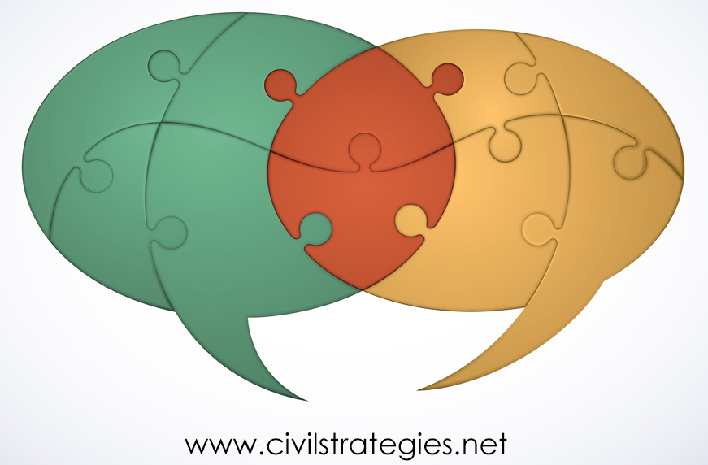
Widening Participatory Dialogue to Improve Public Engagement, Messaging and Program Impact
For: Montgomery County Office of Community Partnerships, 15 December 2020
© 2020 Deborah L. Trent, Ph.D.

Slide 2
Outline
Culturally Responsive Design, Monitoring & Evaluation
Concepts, Context & Process for Widening Stakeholder Participation, Dialogue &
Public Engagement Impact
Theorizing Change through Strategic Public Engagement
Analytical Methods & Variables
Findings
Strengths & Weaknesses
Application to Vaccine Hesitancy Reduction Efforts
2
Notes:
I’ll start with an underlying theory of behavioral change and sketch a conceptual framework including some assumptions about strategic stakeholder engagement and what compels it. Then, I’ll move to the three cases where I tested the culturally responsive, participatory dialogue-design, monitoring and evaluation (CRDM&E) approach. Following that are the methodology, methods, and findings that have led to this approach.
The challenge is to make the approach qualitatively and, if feasible, quantitatively rigorous, yet practical for the current challenge to engage and persuade our communities to get vaccinated. The approach should also facilitate project reporting.

Slide 3
CRE: historical, political, relational, and discursive forms of power (Stickl Haugen and Chouinard, 2019) DM&E: participatory, inclusive communication (Dagron, 2001; Zaharna, 2010; Quick & Feldman, 2011; Waisbord, 2014, 2015; Pamment, 2016; Trent, 2018) + genuine dialogue (Fitzpatrick, 2011; Trent, 2018)
Culturally Responsive Evaluation
Program Design, Monitoring and Evaluation
Culturally Responsive Design, Monitoring and Evaluation
Notes:
PRESENTATION PURPOSE
Governing democratically means upholding freedom of expression about individual human rights, cultural heritage, social injustice and inequality, and corruption while safeguarding health and preventing violence – all to craft policy and programs that are responsive to people’s needs and grievances. Put another way, it involves mediating power struggles. Good governance holds value and use of deliberative democratic communication and analytical tools and processes to shape programs that address unequal power and cultural differences.
The purpose of this presentation is to show how a recognition of power dynamics and use of relational-to-transformational public communication and engagement help in increasing community-government trust, particularly now, as the county faces the challenge of public awareness and education to minimize the potential of coronavirus vaccination hesitancy.
“Culturally responsive” evaluation, or CRE, “recognizes that demographic, sociopolitical, and contextual dimensions, locations, perspectives, and characteristics of culture matter fundamentally in evaluation (Hopson, 2009, 431, in Hood, Hopson, Kirkhart, 2015, 283). CRE measures power in four dimensions: the historical and temporal, the political, the relational, and the discursive (Stickl Haugen and Chouinard, 2019 ,378). This framework integrates CRE with cyclical program design, monitoring, and evaluation, or DME (Trent, 2018). CRDM&E is a path for administering a diverse civic square, with its focus on cultural norms and beliefs, on understanding and balancing power, and on engaging with participatory, inclusive communication and genuine dialogue.

Slide 4
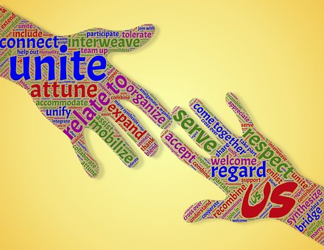
Dimensions of Mediating
Conflict Mediation
Managing Mediatization
Relationship-building
4
City-to-City Cooperation
Integrated DM&E
Notes:
https://pixabay.com/en/photos/?q=control
https://pixabay.com/en/photos/?q=mediating
https://pixabay.com/en/photos/?q=relate&hp=&image_type=all&order=popular&cat=&min_width=&min_height=
https://pixabay.com/en/photos/?q=relate&hp=&image_type=all&order=popular&cat=&min_width=&min_height=
http://www.iuc.eu/city-pairings/
Mediating on local to global levels has five key dimensions:
1. Administering new and expanded relationships.
2. Negotiating, representing and managing mediatizing forces and their increasingly advanced and accessible communication technologies.
3. Providing conflict mediation.
4. Promoting city-to-city, cross-border cooperation.
5. Integrating project CRDM&E from the outset of project planning.

Slide 5
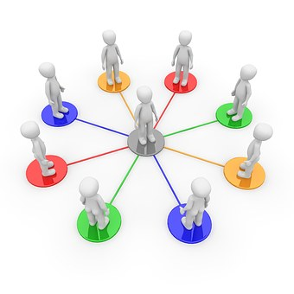
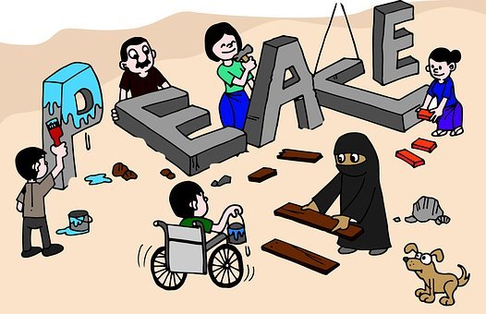
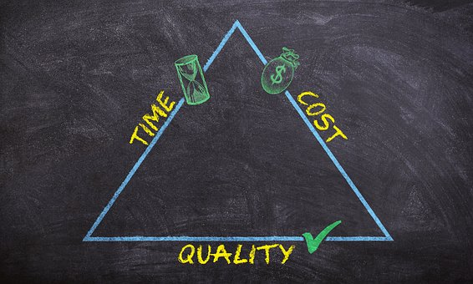
Context & Process Operationalized
Partnerships
Identity
Racial Equity & Social Justice
5
Participation
Design, Monitoring & Evaluation
Dialogue
Notes:
Power politics of all kinds -- in the struggle for racial equity and social justice, over identity, gender, national, tribal, water, trade rights – involve diverse stakeholders, requiring mediation in order to effect positive behavioral change. Public managers, including local to global diplomats, mediate relationships to build trust, cooperation, and strong partnerships, the organizing principle of the Office of Community Partnerships.
As a multi-stakeholder collaboration process, partnership can be a particularly credible and effective mediating process for administering services and projects involving diverse stakeholders and program implementers. Community partnerships and public-private partnerships , or P3s, offer broad opportunities for fostering mutual understanding and economic opportunity.
How do we operationalize the contextual and process variables required to mediate these partnerships?
In the present dialogic, participatory approach to CRDM&E, the contextual variables include the complexities of national and subnational diplomacy due to globalization, the rising power of diverse non-state actors, and the challenges in translating strategy to programs. Here, the programs are US-government-funded global partnerships and sister city partnerships, including the county’s twinning with Morazan, El Salvador.
Key public engagement processes for CRDM&E in this context are cross-sector partnering, mediating and dialogic, participatory communication.
https://cdn.pixabay.com/photo/2012/12/14/11/36/virtual-identity-69996__480.jpg
https://pixabay.com/get/5ee4d74b4d55b108feda8460da29317e153cd9e6535571_1920.png
https://cdn.pixabay.com/photo/2015/11/03/08/54/network-1019778__480.jpg
https://pixabay.com/en/photos/?q=process&pagi=2
People with dialogue signs is from USC so also probably CC
https://cdn.pixabay.com/photo/2017/05/06/05/33/peace-2288958__480.jpg

Slide 6
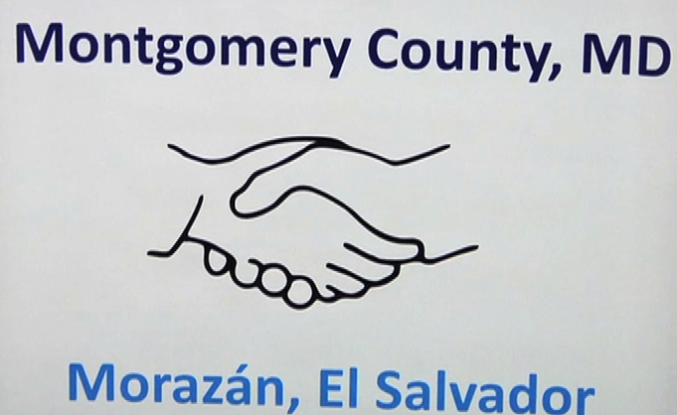
Three Cases
6
Notes:
My 2018 qualitative study of three cross-sector partnerships in public and citizen diplomacy, and subsequent research on mediating voluntary community organizations and government agencies and culturally responsive evaluation, measure the quality and impact of public engagement according to the 15 practices of participatory communication and eight methods of genuine dialogue. Methods include participant observation, interviews, and desk research. The three partnerships are: the International diaspora Engagement Alliance (IdEA) – funded by U.S. Department of State and Agency for International Development, with Calvert Impact Capital (formerly Calvert Foundation) as the managing partner from 2013 to 2016; the Chicago-Kyiv Sister City partnership, established in 1991; and the sister city between Montgomery County, Maryland, and the El Salvadoran state of Morazán, launched in 2011. The three meet the selection criteria of cross-sector relationship-building that include: demographically diverse, global publics – i.e., ethnic diasporas; significant contribution of resources from the public, nonprofit and private sectors; local-to-global public sector stakeholders; and program goals spanning education, culture, health, trade & tourism, good governance and philanthropy.
The three cases feature public engagement with substantial voluntary nongovernmental stakeholder-participants, cultural diversity, space for participants to independently design, monitor, and evaluate their programs according to their interests, skills, and networks, and participant-led mediating of power imbalances in order to carry out their missions of cross-cultural awareness and cooperation.
Culturally responsive program design to address public problems starts with stakeholder mapping and surveying with an aim to develop a theory of change. In these partnerships, letters of agreement, reports, interviews, and stakeholder dialogue reflect broad visions as well as specific goals in each of the three cases. However, in no case was there an explicit theory of change. Instead, in this post hoc, non-experimental impact evaluation, I analyzed narrative patterns and themes in the context of the material results to ground a theory of change for each case.
http://www.diasporaalliance.org/
http://www.chicagosistercities.com/events/gala-banquet-for-the-25th-anniversaries-of-ukrainian-independence-and-the-sister-city-anniversary-between-chicago-and-kyiv/
http://s19499.pcdn.co/wp-content/uploads/2012/04/Salvadoran-Delegation-CRTW-Ep.106-04-27-12-e1423764710896.png
--------------------------

Slide 7
Theories of Change
IdEA: Using an events strategy to offer networking and tailored training opportunities along with mentoring and small grant programs, IdEA seeks to increase diaspora integration into diplomacy and development and promote investment, entrepreneurship, philanthropy and volunteerism in heritage countries.
Kyiv: With limited financial support for exchanges, the experienced volunteers aim to foster lasting relationships and collaborative projects across the health care, manufacturing, arts, tourism and government sectors that benefit individuals and tourism, trade, diplomacy and public service delivery in both cities
Morazán: Largely through voluntary community-based organizations, these sister cities strive to increase citizen engagement, events and exchanges dignifying Salvadoran culture, educational opportunity, health care delivery, public/private-sector accountability and living standards.
7
Notes:
The organizing theory of change underlying this participatory dialogue approach for relational messaging/communication and evaluating impact in citizen engagement, diplomacy and peacebuilding is two-fold. The first source of change is in opening up communication channels and dialogue by widening participation – thereby strengthening mutuality and credibility-by including diverse, affected stakeholders – known as “strategic publics.” Second, change happens when project partners measure both the quality of communication in relationship-building and the quantitative material results of the relationship-building and projects they undertake. The shorthand for this inclusive, strategic stakeholder participation in relationship-building and project CRDM&E is “strategic engagement.” Because the approach stresses inclusive, participatory CRDM&E, it stands to foster an organizational culture of research and evaluation in the participating organizations.
Letters of Agreement, reports, interviews, and stakeholder dialogue reflect broad visions as well as specific goals in each of the three cases. However, in no case did I find a stated theory of change. Instead, in this post hoc, non-experimental impact evaluation, I analyzed narrative patterns and themes in the context of the material results to ground a theory of change for each case.
Since this evaluation lacks random assignment of comparison (control) and treatment groups and pre-program measurement, there is only qualitative validation that the partnerships are responsible for the behavioral change and wider impacts theorized here.
These three theories of change clearly require further validation of cultural responsiveness to stakeholder needs and interests as well as long-term sustainability.

Slide 8
Inclusive stakeholder management
Relationship-Building
Genuine Dialogue
Outputs, Feedback & Adjustments
Confidence-building & Credibility
Outcomes & Impacts
Trust & Collaboration
Participatory Communication
Mediating
and
Evaluating
Engagement,
Power
Dynamics, and
Relational Messaging
and Other
Programs through…
…Culturally Responsive Design, Monitoring & Evaluation
6
Notes:
This is a process view of the overall theory of change for mediating public engagement to improve messaging campaigns and delivery of other programs. The process moves from inclusive stakeholder management and 15 dimensions of participatory communication to eight Genuine dialogue practices that build trust and confidence and consensus among stakeholders and more credible, sustainable programs. The next several slides provide some detail.

Slide 9
Measuring project Communication quality and material results
Genuine Dialogue
Participatory Communication
Foci
Outputs
Outcomes
Impacts
Notes:
This slide unpacks the monitoring and evaluation steps in the cycle. The quality of communication among partners and stakeholders in the three cases is measured with a rubric combining “genuine dialogue” and “participatory communication.”
Genuine dialogue connotes mutual, deliberative, “power-free” decision-making to navigate complicated local to global networks of communities with shared and divergent interests.
“Participatory communication” draws on stakeholder management and corporate social responsibility to aid in identifying with whom to engage strategically, as well as relationally.
Material results of IdEA, Chicago-Kyiv, and Montgomery County-Morazán are measured as outputs, outcomes and desired impacts generated through the dialogic, participatory communication and relationship-building in the partnerships.
Interviews, document and media analysis and participant observation were the key data gathering methods for measuring strategic engagement in these partnerships.

Slide 10
15 Participatory Communication Practices*
Listening Openly
Expressing Voice
Relating as Partners
Forming Multiple Information Channels
Jointly Strategizing, Implementing, Evaluating
Increasing Horizontal Dialogue
Prioritizing Process
Designing Messages Together
Raising Consciousness
Activating Informal/Formal Networks
Contextualizing Policy Problems
Fostering Inclusiveness, Continuity, Diversity
Encouraging Ownership
Deliberating to Understand and Motivate
Experimenting to Transform and Sustain
____________________________________________
*Dagron, 2001; Zaharna, 2010; Quick & Feldman, 2011; Waisbord, 2014, 2015; Pamment, 2016; Trent, 2018
8 Genuine Dialogue Practices*
Mutuality
Presence
Commitment
Authenticity
Trust
Respect
Collaboration
Risk
____________________________________________
Fitzpatrick, 2011; Trent, 2018
Notes:
The participatory communication and genuine dialogue practices are qualitative measures in international development, cross-cultural communication, and diplomacy program evaluation. They transfer to other policy and program platforms. Many of these practices are mutually reinforcing, as explained in detail at https://static1.squarespace.com/static/568cd8a0dc5cb4a5b51a8db1/t/5aabfe9b562fa7e1f7c0d883/1521221277165/How+Mutual+Dialogue+and+Participatory+Communication+Work+Together.pdf

Slide 11
10 (table continued on next slide)
Notes:
Dialogic and participatory communication marries eight genuine dialogue and 15 participatory communication practices to mediate diverse stakeholder experiences, interests and perspectives in the strategic engagement process.
Part 1 of the table, pictured here, contains five of the 15 participatory communication practices – from Listening Openly to Jointly Strategizing, Implementing, and Evaluating. They are cross-referenced with the eight genuine dialogue practices – from Mutuality to Risk.
Some of the practices reinforce one another – as indicated by the blue inverted triangles. For example:
The participatory communication practice of listening openly to absorb multiple perspectives in problem definition, goal-setting, reporting and codifying DM&E processes reinforces the dialogic acts of presence and respect. Here, diplomatists are in close proximity and open to engaging with diverse stakeholders affected by a current or contemplated program before its implementation. Respect comes in recognizing these stakeholders as strategic publics.

Slide 12
12
Notes:
Here are the remaining ten participatory communication practices, from Increasing Horizontal Dialogue to Experimenting with various projects to Transform behavior and Sustain the change.
Examples of the strategic value of designing messages together was found in both sister city exchanges, whether in the humanitarian work of Chicago-Kyiv providing relief to Ukrainians during the Maidan revolution or the Morazán committee building on the Salvadoran Vice President’s and Montgomery County Council president’s messages of hope that Salvadorans in the county continue contributing remittances as well as human resources and infrastructure and to break down racial barriers. The genuine dialogue practice of Risk and Deliberative participatory communication came up in this connection, too, when a Maryland participant recalled how she decided to take her daughter to Morazán although her husband was initially not in favor and was only convinced after they both talked through the decision. Mother and daughter ended up making multiple trips, many years in a row, to volunteer and site-see.

Slide 13
SELECTED FINDINGS: INTERNATIONAL diaspora Engagement Alliance (IdEA)*
Pillars and Goals | Outputs | Outcomes | Impacts
Pillars: Investment & Entrepreneurship Philanthropy Volunteerism Innovation | More than 200 conferences, forums, and events, including 160 during Global Diaspora Week in 2014 and 2015. | Capacity-building across sectors. | Increased diaspora engagement in investment & entrepreneurship, philanthropy, volunteerism, and sustainable development in heritage countries.
Expand diaspora engagement in development and diplomacy | Networking virtually and in person to connect and collaborate. | Promotion of corporate social responsibility among private sector partners. | Strengthened diaspora community-building and capacity to build bridges across generations, cultures, ethnicities, and nationalities.
Build skills and reputation of diaspora organizations as agents of cross-cultural understanding and socioeconomic development | 37 partnerships to design and conduct capacity-building training webinars on organizational strategy, fundraising, management of social media and volunteers, and other topics. | Empowerment of diasporas through training, networking, access to public speaking opportunities. | Larger role for nonprofit and private sectors and P3s for integrating diplomacy and development.
*Sources: http://www.diasporaalliance.org/idea-infographic-2014-2016/, interviews, IdEA Impact Report (August, 2016).
Notes:
Example findings from the IdEA P3 are above. They show how the participatory/relational communication and genuine dialogue practices generate outputs, outcomes and impacts.
https://static1.squarespace.com/static/568cd8a0dc5cb4a5b51a8db1/t/5ab5809b352f534a0910775b/1521844380444/032318+Outputs%2C+Outcomes%2C+Impacts+of+Three+Diaspora-Engaging+Public-Private+Partnerships.pdf, page 4:
Two other major efforts noted in the IdEA Impact Report were promoting diaspora participation in the Latin American Impact Investing Forum in 2014 and 2015 and convening the African Diaspora Investment Symposium in 2014 and 2016. The former is Latin America’s largest impact investing conference, where IdEA and the U.S.-Mexico Foundation co-hosted an unprecedented gathering to engage diaspora.7 The latter symposium was conceived and initiated by IdEA in 2014 and first held in Washington, D.C., and then in California’s Silicon Valley.8 Collectively – due to IdEA, partners, and lead stakeholders, principally the African Diaspora Network, that hosted the 2016 symposium and the most recent one in early 2017 – over 600 attendees in business, nonprofit development, and education created new initiatives to strengthen U.S.-African diaspora engagement and address the Sustainable Development Goals.9
Other goals, outputs, outcomes and impacts were also achieved in the IdEA program, but it was discontinued after the Obama administration though some of the partnerships and lasting diaspora engagement has endured due to the popularity of the program among embassies (ETC if you like), all of which are evidence of power and help explain how and why programs are culturally responsive if not sustainable and address stakeholder needs.
FN5 “IdEA Impact Report,” made available by the Office of Global Partnerships, (August, 2016). FN6 Ibid, p. 13. FN7 Ibid, pp. 34-36. FN8 Ibid, pp. 31-33; http://www.diasporaalliance.org/idea-infographic-2014-2016/; http://www.africandiasporanetwork.org/wp-content/uploads/2016/10/2016- ADN_PostSymposium_Summary.pdf FN9 Ibid; http://www.africandiasporanetwork.org/wpcontent/uploads/2017/03/ADIS2017-Symposium-Synopsis.pdf ; http://www.un.org/sustainabledevelopment/sustainable-development-goals/

Slide 14
FINDINGS: Chicago-Kyiv Sister City Committee*
Foci | Outputs | Outcomes | Impacts
Medical services | Exchanges and events: 1-Signing of the SC agreement 42-Culture 33-Education 20-Government 14-Health/medical and social services 8-Economic development/ business 4-Media 2-Sports 2-Humanitarian 2-Celebration 1-Environment 1-Diplomatic 1-Mayoral visit/street-naming 4-New Partnerships Total = 135 | Better trained medical professionals and improved health care facilities. | Raise quality of mental and physical health care delivery.
Trade/tourism |  |  | Continue the 26-year pattern of long-lasting individual relationships, projects, welcoming community, and promotion of trade and tourism.
 |  | Save lives and heal society.
Culture |  |  | Continue the 26-year pattern of long-lasting individual relationships, projects, welcoming community, and promotion of trade and tourism.
 |  | Expand opportunities for Ukrainian youth; open minds to change.
Education
 |  | Enhanced cross-cultural understanding. | Increase cross-cultural awareness and competency.
 |  | Foster improved public service delivery, from education to anticorruption.
Agriculture
Immigration and naturalization |  | Strengthen commercial ties across agricultural and manufacturing sectors. | Foster governmental and private sector transparency and reform.
Humanitarian response
 |  | Increase international goodwill and sportsmanship.
 |  | Improve current infrastructure and prevent future environmental hazards.
 | 26+ Fundraisers
 | $100,000+ value of in-kind donations
*Sources: “History of Exchange” (http://chicagosistercities.com/wp-content/uploads/2013/03/Kyiv-2013.pdf) and unpublished update, interviews, and desk research.
Notes:
Examples from this sister city partnership:
The partners are linked directly to the office of the mayor, the Chicago consular corps, and banks and other businesses that partner on the committee’s goals to increase ties in medicine, economic development, tourism, culture, education, and other areas (see the foci in column one of Table 2, below). The genuine dialogue practice of commitment, in this case to improving governance and humanitarian response, also grounds the committee’s projects26 (page 7). An impact of the partnership is that it reinforces the welcoming community policy toward new Chicagoans by city government. It also fosters cross-cultural competency, tourism and trade, and better governance through exchanges in both locales (page 12). 26 How Practices of Genuine Dialogue and Participatory Communication Work Together in Public and Citizen Diplomacy Partnerships (page 13).

Slide 15
Findings: Montgomery County-Morazán Sister City Committee*
Foci | Outputs | Outcomes | Impacts
Youth | Exchanges and events: 1- Exploratory Trip 1- Signing of the SC agreement 23-Culture 14-Socioeconomic justice & development 2 -Education 1-Government 1-Economic development/business 1-Sports 2-Celebration 4-New Partnerships Total=50 | Strengthen educational and career opportunities for youth through scholarships and instructional assistance. | Higher quality education and healthcare.
Education
Culture
 |  | Update medical and educational equipment and facilities. | Improved local governance and civil society/private sector engagement.
Health
Economic development
 |  | Enhance cross-cultural understanding. | Migration by choice rather than necessity.
Local governance
 |  | Strengthen business ties.
Social support for recent immigrants
 | $12,000+-Fundraising
Science/technology** | $30,000+-In-kind donations
*Sources are interviewees, online research, and media reports. Several interviewees who have been lead stakeholders in the partnership reviewed the table. **An interviewee advised that the exchanges have not yet included science or technology.
Notes:
Both the Morazán and Montgomery County partners consider youth outreach and engagement to be inextricably linked, top priorities for both locales. Most foci of the partnership are tied to opportunities for future generations. Through cultural, educational, technical, and business activities, Salvadoran and Salvadoran American youth have opportunities not only to advance their skills, but inform a healthy sense of belonging and identity to, or familiarization with, both cultures.35 35 Strategic engagement that fosters constructive national identity development resonates with the collaborative public diplomacy of Lucian Hudson, The Enabling State: Collaborating for Success (United Kingdom Foreign and Commonwealth Office, 2009) and Ali Fisher, “Looking at the man in the mirror, understanding of power and influence in public diplomacy,” in Ali Fisher and Scott Lucas (eds.), Trials of Engagement: The Future of US Public Diplomacy (Martinus Publishers, 2010), pp. 271–295…. Page 15: Other cultural outputs of the partnership that support both youth opportunity and education have occurred several times yearly or ad hoc. According to a lead stakeholder, seven intergenerational exchange visits by MoverMoms41 from 2010 to 2015 found teams of parents and their school-aged children facilitating enrichment programs at a primary/secondary school in the Department and donating recreational equipment, art, and other supplies.42 (A Peace Corps volunteer working in the Salvadoran education sector helped MoverMoms identify the school.) Over those five years, the Marylanders engaged with approximately 200 Salvadoran schoolchildren along with some of their parents and teachers. The non-profit Hungry for Music also donated money for instruments to a Salvadoran community center. 41 http://www.movermoms.org/index.html# 42 http://www.montgomerysistercities.org/Morazán.html [but the links are no longer active)

Slide 16
So What? Strengths and Limitations
Introduces a strategic framework for mediating and measuring inclusive, participatory dialogue and impacts of citizen engagement through public and citizen diplomacy partnerships
This strategic engagement framework incorporates relational communication, international development, and culturally responsive practices in design, monitoring and evaluation
Because it centers on mediation of diverse stakeholders, strategic engagement can contribute to a culture of research and evaluation in the partner organizations
For less generalizable results at comparatively low project cost, the participatory CRDM&E approach can be implemented post hoc, in a nonexperimental design
To increase generalizability, the approach should include mixed methods, randomly selected control and treatment groups, and longitudinal data collection.
16
Notes:
On bullet 3, IdEA in particular contributes to a culture of research and evaluation in the diplomatic and peacebuilding communities. The sustainability of IdEA’s impacts as measured by the partners and in this study can be analyzed quantitatively in years to come.
Also to point 3 as well as 4, studying the sister cities provides insights into how volunteers can work with communities and exploit low-cost resources to conduct CRDM&E without causing volunteer fatigue.
Future evaluations would be improved by designing a mixed-methods impact evaluation at the outset of project design with a larger data set, research team and budget. Ideally, research design would include randomly assigned, inclusive treatment groups of lead and participant stakeholders and control groups of people not participating in a P3. Random selection of treatment and control groups is necessary to compare how much change can be attributed to P3 and how much could be because of unknown or unobserved counterfactual variables. Comparing the results of partnering or not involves quantitatively analyzing outputs, outcomes and impacts and qualitatively gauging the intensity level of dialogic and participatory communication practices, as well as attitudinal change. Likert response scales could be used in an interview or survey questionnaire. The catch 22 is that we need results to get more attention and funding. It takes leadership to change the politics of research and evaluation.

Slide 17
Conclusion
Participatory, inclusive dialogue and relational messaging are integral to the Culturally Responsive Design, Monitoring & Evaluation framework
CRDM&E can support OCP efforts to reduce coronavirus vaccine hesitancy among county residents and workers
Volunteers and staff can be trained in CRDM&E relatively easily through partnering with county public health agencies, Montgomery College nursing educators, and community-based organizations.
17

Slide 18
Background Information
“Many Voices, Many Hands: Widening Participatory Dialogue to Improve Diplomacy’s Impact”: http://uscpublicdiplomacy.org/sites/uscpublicdiplomacy.org/files/useruploads/u39301/Many%20Voices%2C%20Many%20Hands%20Web-Ready%205.30.18.pdf
Additional literature review and data: http://www.civilstrategies.net/about/
Contact info: dtrent@civilstrategies.net; @dlt4pd
18

Slide 19
Thanks! Questions?
dtrent@civilstrategies.net
@dlt4PD

